Slide 1
CH2PH2:
Surfaces and Interfaces
Dr. James Hallett
j.e.hallett@reading.ac.uk

Slide 2
CH2PH2
Lecture 3: Thermodynamics of micelles

Slide 3
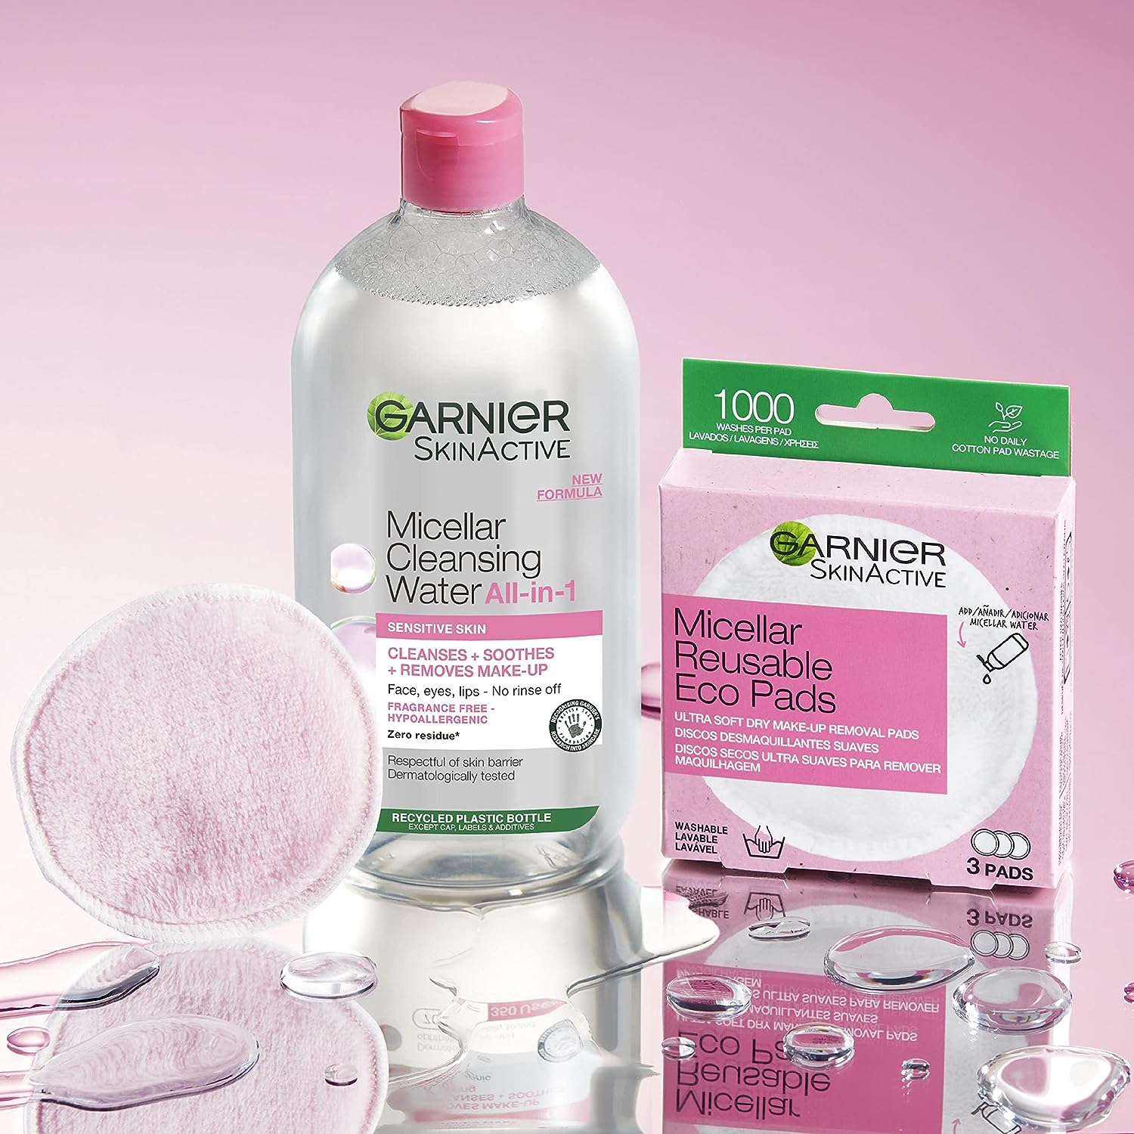
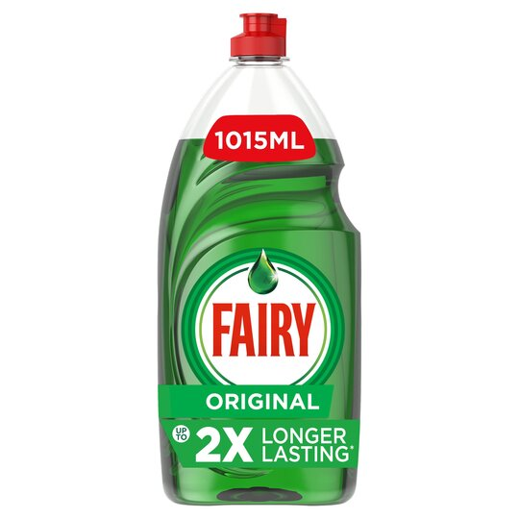
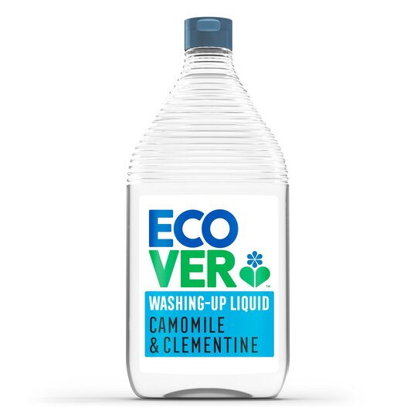
Micelle applications
Widely used as active ingredient in cosmetics, formulations for household products

Slide 4
What makes a good washing up liquid?

Slide 5
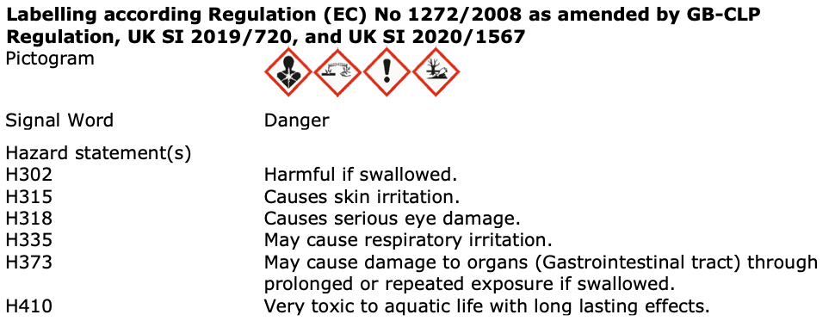
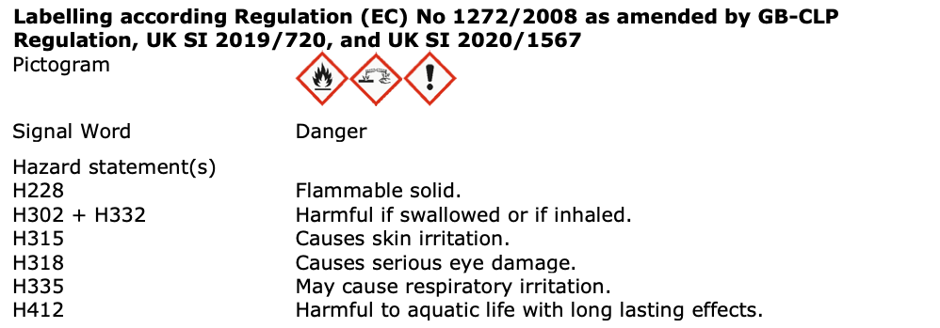
Micelle applications

Slide 6
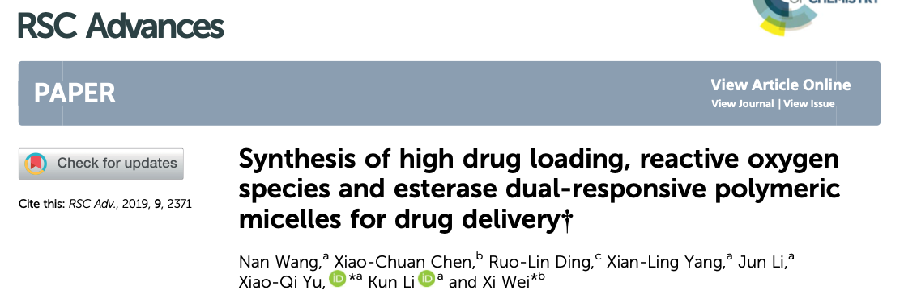
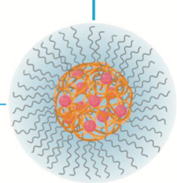

Micelle applications
Of growing use in targeted drug delivery
Allows for previously disregarded drugs to be re-evaluated

Slide 7
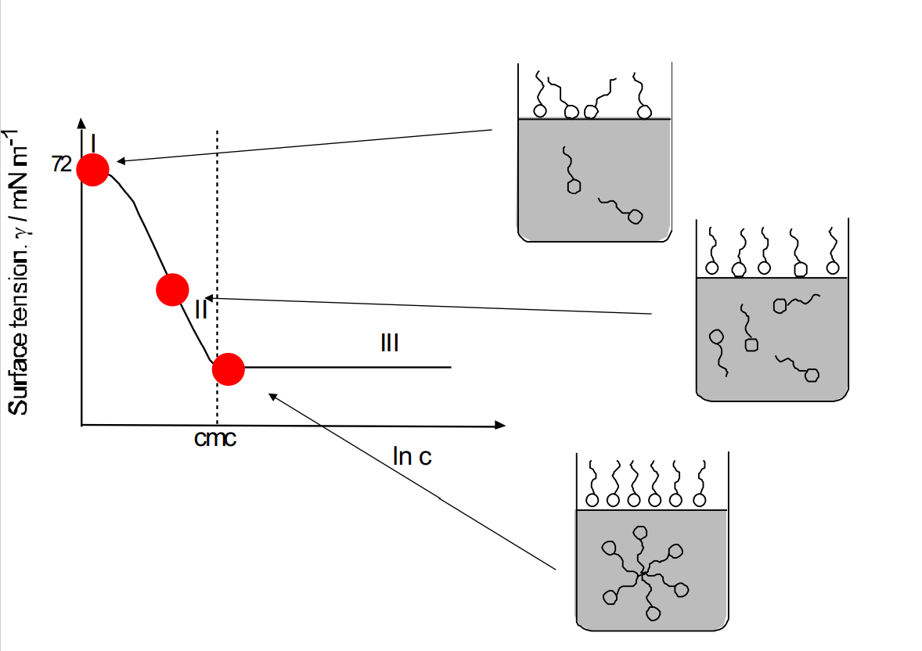
Recap: surface tension
Correlation between surface activity and micelle formation.

Slide 8

Recap: Surface tension regimes
Consider behaviour in three regimes
(i) Regime I: Two-dimensional “ideal gas behaviour”
(ii)Regime II: Linear relationship (between 𝛾 and lnc) – Gibbs adsorption isotherm
(iii) Regime III: Increasing the concentration leads to more micelles forming in bulk, with no further changes at the surface

Slide 9
Recap: Surface excess
The Gibbs adsorption equation Relates surface excess (number of moles in excess at surface per unit area) to gradient of 𝛾 versus ln(c) plot in regime II (where this slope is linear).
For example:
Γ_{s}=10⁻⁶ mol m⁻²
1/N_{a}Γ_{s}=1.66 ✕ 10⁻¹⁸ m² per molecule
1/N_{a}Γ_{s}=1.66 nm² per molecule
The surface excess Γ may be inverted to obtain the area per molecule. So, surface tension vs concentration measurements can give us the area per molecule in surface monolayers, as well as determination of the cmc.

Slide 10
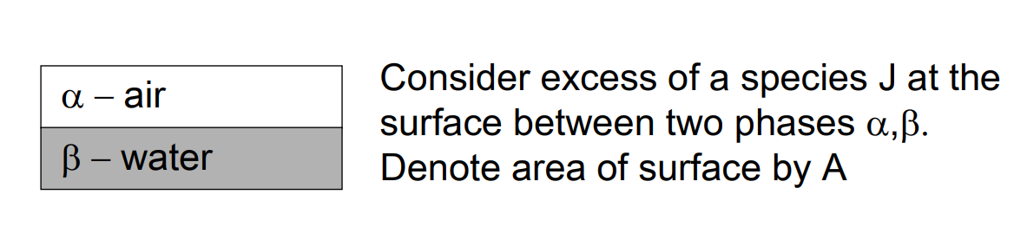



Excess Gibbs Energy
The excess Gibbs energy is the difference between the Gibbs energy of the total system and that of the two isolated phases:
$$G_{exc}=G−\{G\left(α\right)−G\left(β\right)\}$$
The excess moles of surfactant can be defined similarly:
$$n_{exc}=n_{J}−\{n_{J}\left(α\right)−n_{J}\left(β\right)\}$$
The surface excess is thus defined as:
$$Γ=\frac{n_{exc}}{A}$$

Slide 11


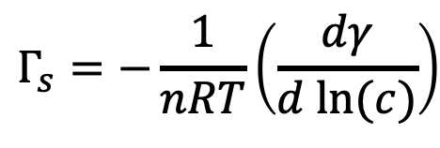
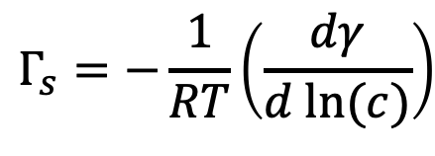

Surface excess and surface tension
From the Gibbs-Duhem equation:
$$dγ=−Γ_{s}dμ_{s}$$
μ is the chemical potential
From the definition of chemical potential
$dμ_{s}=RT d ln(a)$
For dilute solutions where activity and concentration are approximately equal
$dμ_{s}=RT d ln(c)$
Combining the first and third equations:
So excess surfactant can be measure by plotting surface tension versus ln(c).
$$Γ_{s}=−\frac{1}{RT}\left(\frac{dγ}{d ln⁡(c)}\right)$$
Form used if each mole of surfactant produced n moles of ions.
$$Γ_{s}=−\frac{1}{nRT}\left(\frac{dγ}{d ln⁡(c)}\right)$$

Slide 12
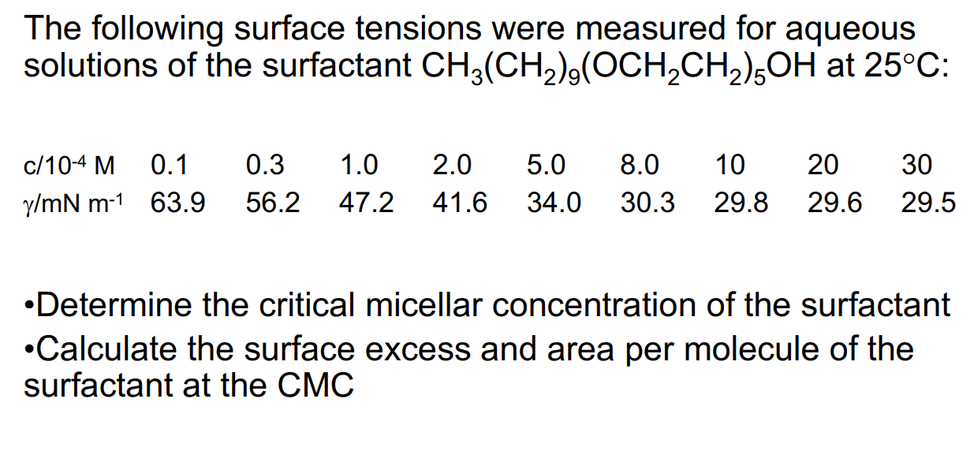
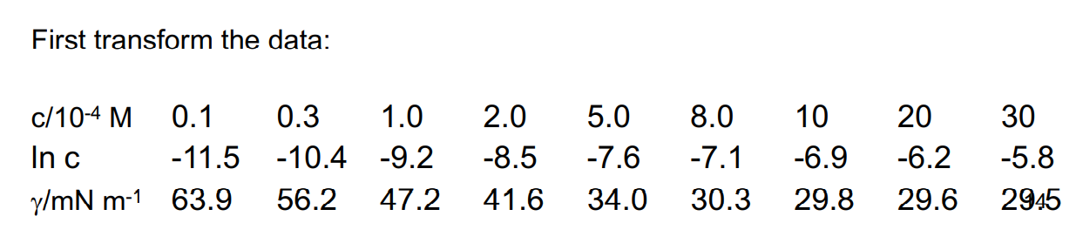
Surface excess and surface tension

Slide 13
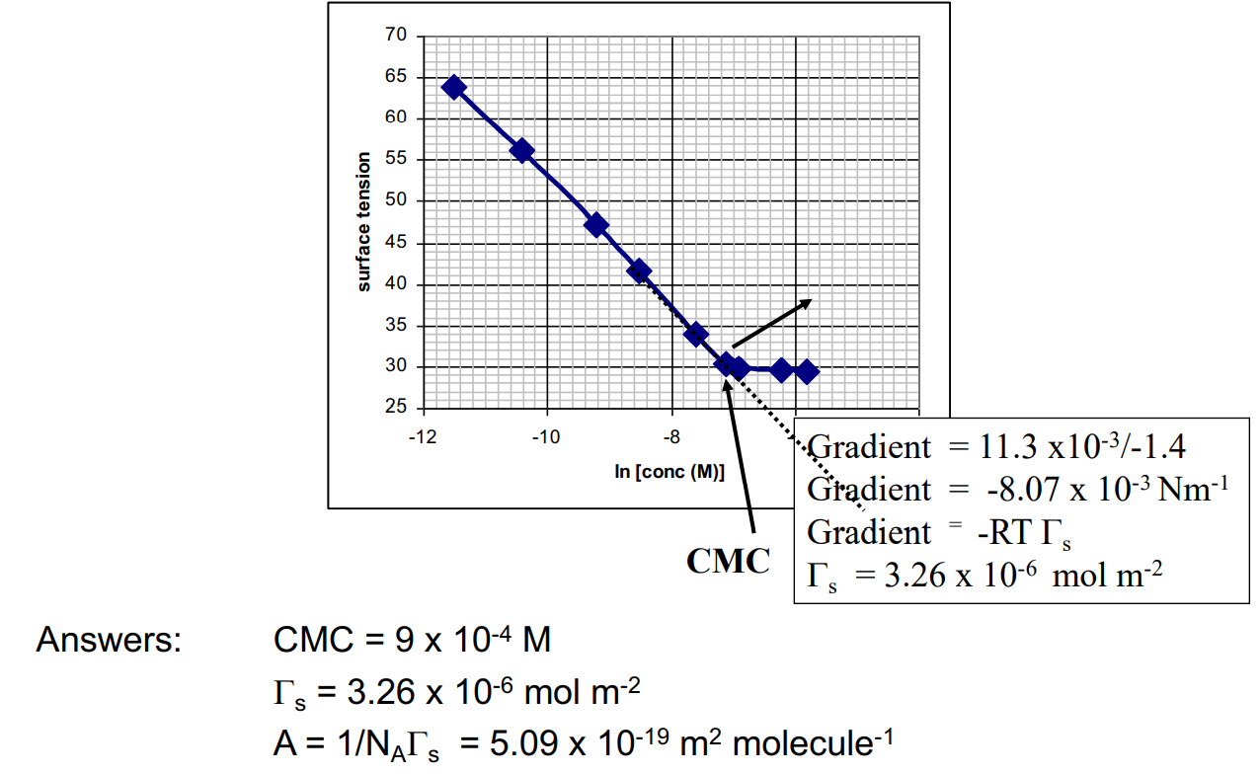
Surface excess and surface tension

Slide 15




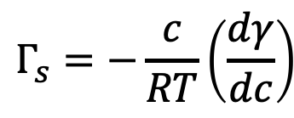
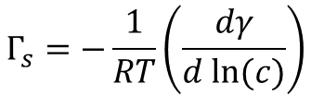
Surface excess and surface tension
Going back to regime I:
the surface tension decreases linearly with concentration
$$γ=γ_{0}−kc$$
k is a constant
$$\frac{dγ}{dc}=−k$$
Taking the derivative
$$Γ_{s}=−\frac{1}{RT}\left(\frac{dγ}{d ln⁡(c)}\right)$$
Borrow this from above and rearrange!
$$Γ_{s}=−\frac{c}{RT}\left(\frac{dγ}{dc}\right)$$
And then setting the 2nd and 4th equations equal:
$$\frac{Γ_{s}RT}{c}=k$$
$$Γ_{s}RT =kc$$

Slide 16





Surface pressure
We define the surface pressure:
$$π=γ_{0}−γ$$
Using the first equation above we get:
$$γ=γ_{0}−kc$$
$$π=kc$$
And finally we get:
$$Γ_{s}RT =π$$
Subbing in the definition of surface excess we get:
$$n_{exc}RT =πA$$
Look familiar?

Slide 17
Micelles
Summary so far:
In dilute solution (regime I) the molecules in the monolayer at the air-water surface are not very densely packed and can be considered to form a 2-D ideal gas.
The packing density increases with concentration until the monolayer is saturated (regime II). Then G is a constant (and so is the area per molecule). Even in regime II the monolayer is saturated. Molecules have to build up in bulk before reaching the cmc.
Then in regime III, γ is nearly constant, implying G_{s} = 0.

Slide 18


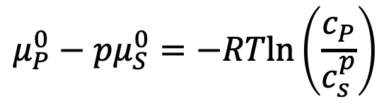

Micelles
Gibbs energy of micellization:
We have p number of molecules forming a micelle at equilibrium:
$$pS⟺S_{p}$$
The chemical potentials of each side can be set equal:
$$pμ_{S}^{0}+pRTln\left(a_{s}\right)=μ_{P}^{0}+RTln\left(a_{P}\right)$$
For a dilute solution where a ~ c, we can rearrange:
$$μ_{P}^{0}−pμ_{S}^{0}=−RTln\left(\frac{c_{P}}{c_{s}^{p}}\right)$$
We use the LHS as the definition of the Gibbs of micellization:
$$G_{mic}^{0}=−RTln\left(c_{P}\right)+pRTln\left(c_{s}\right)$$
Notes:
P number of free surfactant molecules or associated surfactant molecules S_p containing p molecules
Cp concentration of micelles of association number p
Cs concentration of unassociated surfactant.

Slide 19
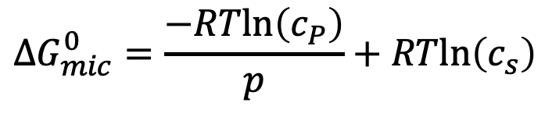
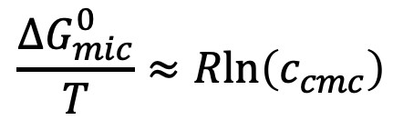
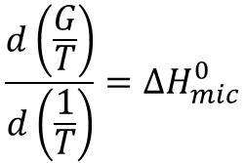

Micelles
We further define the Gibbs energy of micellization per molecule p:
$${ΔG}_{mic}^{0}=\frac{−RTln\left(c_{P}\right)}{p}+RTln\left(c_{s}\right)$$
And if p is large (many molecules per micelle):
$${ΔG}_{mic}^{0}≈RTln\left(c_{cmc}\right)$$
Enthalpy of micellization:
How much heat is given off or released in the formation of a micelle?
We can start from the Gibbs-Helmholtz equation!
$$\frac{d\left(\frac{G}{T}\right)}{d\left(\frac{1}{T}\right)}=ΔH_{mic}^{0}$$
$$\frac{{ΔG}_{mic}^{0}}{T}≈Rln\left(c_{cmc}\right)$$

Slide 20
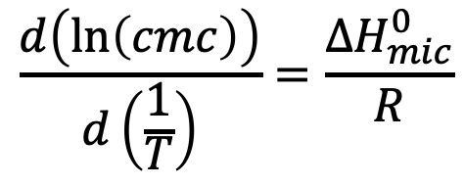
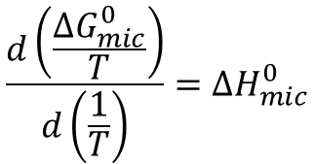

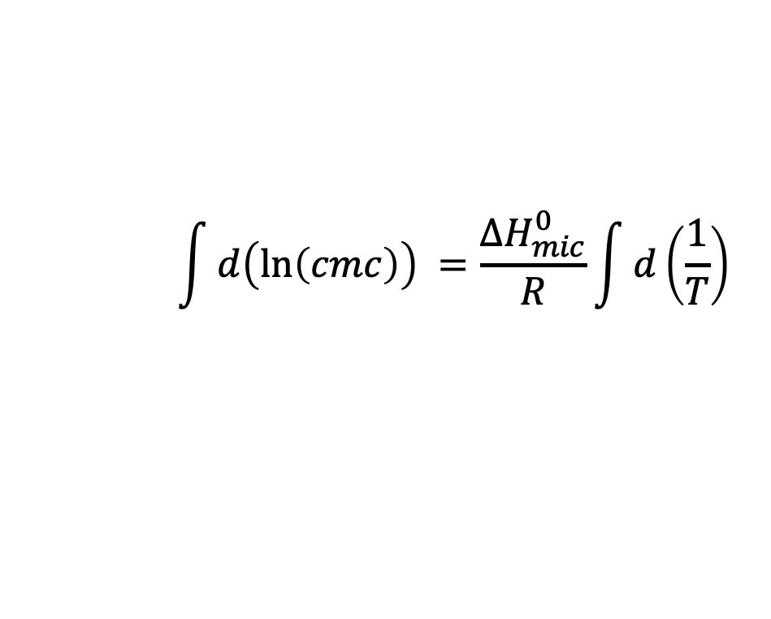
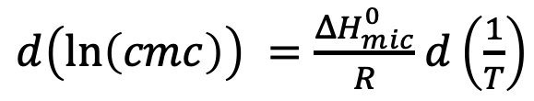
Micelles
Substituting:
$$\frac{d\left(\frac{{ΔG}_{mic}^{0}}{T}\right)}{d\left(\frac{1}{T}\right)}=ΔH_{mic}^{0}$$
$$\frac{d\left(ln\left(cmc\right)\right)}{d\left(\frac{1}{T}\right)}=\frac{ΔH_{mic}^{0}}{R}$$
Rearranging:
$d\left(ln\left(cmc\right)\right) =\frac{ΔH_{mic}^{0}}{R}$ $d\left(\frac{1}{T}\right)$
Integrate!
$$\int{d\left(ln\left(cmc\right)\right)} =\frac{ΔH_{mic}^{0}}{R}\int{d\left(\frac{1}{T}\right)}$$
$$ln\left(cmc\right) =\frac{ΔH_{mic}^{0}}{RT}+C$$
We can use a linear plot to find the enthalpy!

Slide 21
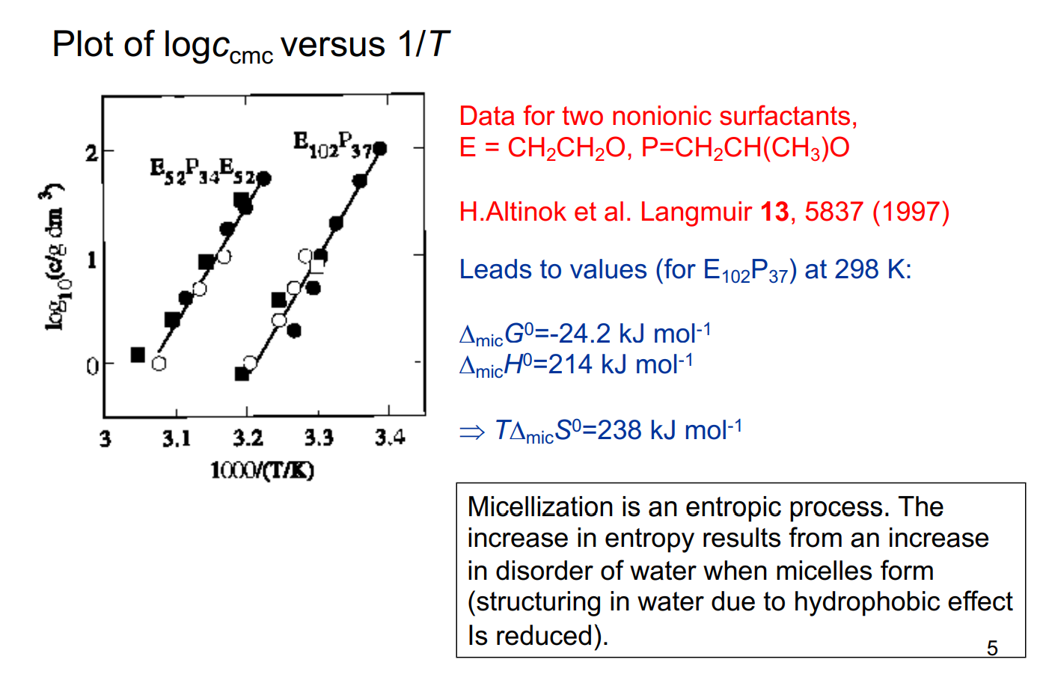
Micelles

Slide 22
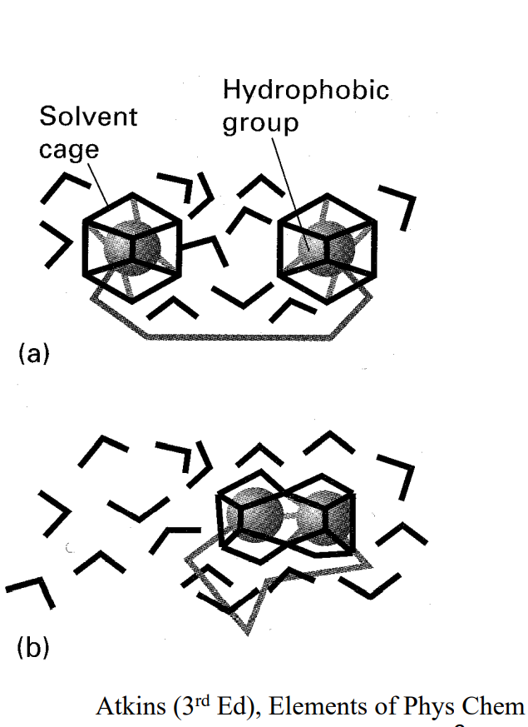
Hydrophobic effect
Largely an entropic interaction.
Responsible for micellization of surfactants and for protein folding with an “oily” inner phase.
Enthalpy of micellization can be exothermic, and cmc increases with temperature, or
Enthalpy of micellization can be endothermic/entirely entropy driven.

Slide 23

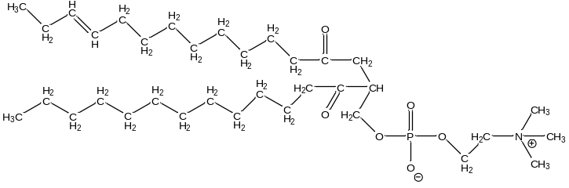
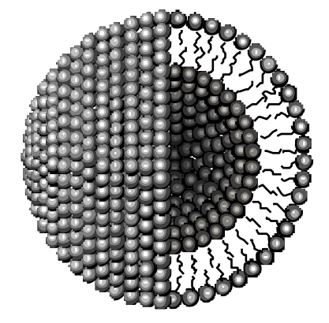
Hydrophobic effect
Effects of the Hydrocarbon tail
Below CMC – presence of hydrocarbon tails within bulk water disrupt water organisation – water molecules are more ordered and hydrocarbon tails are restricted
Above the CMC – hydrocarbon tails come together and bulk disordered structure of water is restored and hydrocarbon tail movement increases •
Contribution of headgroups
Headgroups remain surrounded by water molecules throughout micellisation and do not contribute significantly
Interactions between headgroups do determine the overall size and shape of the micelle

Slide 24
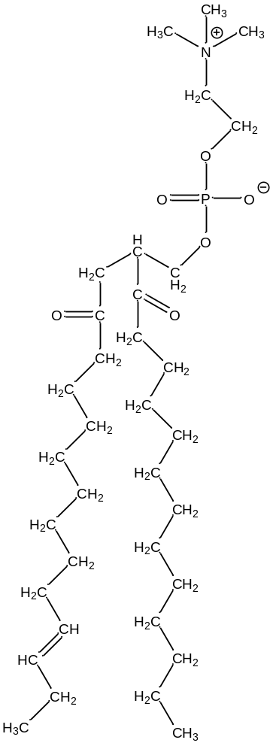

Hydrophobic effect
Cl-
The principle factor in determining cmc is the length of the hydrocarbon tail.
A second factor in determining cmc is the valency of the headgroup charge.
The third factor relevant to the cmc is the valency of the counterions.
A major determinant of cmc is the area of the hydrophobic tail exposed to water. This leads to a logarithmic relationship between the cmc and the alkyl chain length for linear surfactants (N)
Na+
$$log\left(c_{cmc}\right)=aN+b$$

Slide 25
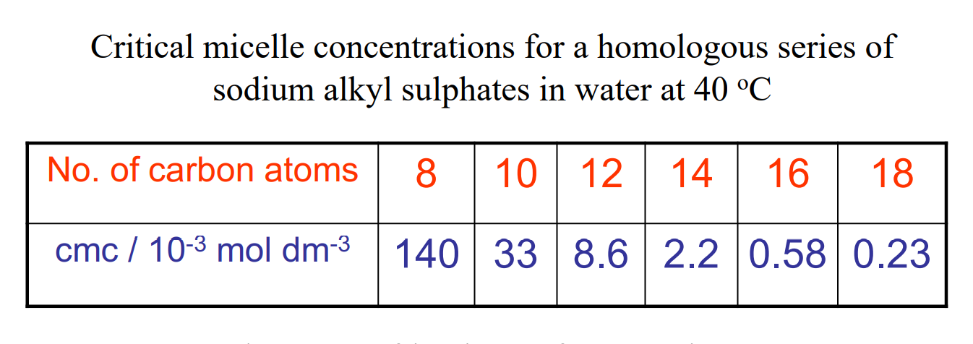
CMC and micelles
In water the cmc of ionic surfactants is approximately halved by the addition of each CH2 group up to ca. C16, C18
Above C16/C18 the cmc tends to be constant – probably due to coiling of the the long hydrocarbon tails
Affect is more pronounced for non-ionic surfactants

Slide 26
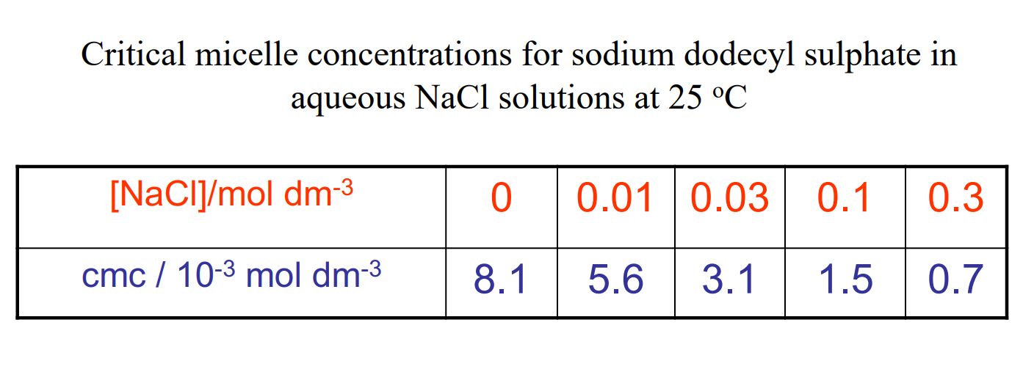
CMC and micelles
A series of other factors also affect the value of the cmc
Temperature – micelle formation is often opposed by thermal agitation (usually exothermic)
Addition of simple electrolytes (ionic micelles) – decreases cmc
Addition of organic molecules – can increase or decrease cmc
For ionic surfactants an increase in electrolyte concentration reduces repulsion between charged groups by screening
Micelle formation is favoured and the cmc is reduced

Slide 27
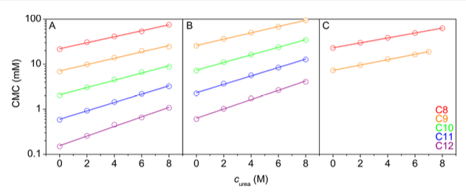
CMC and micelles
Addition of organic molecules can increase or decrease cmc!
Addition of short chain alcohols → Become incorporated into outer region of micelle, reduce electrostatic repulsions and steric hindrance and lower cmc
Addition of ‘sugars’ → ‘sugars’ are structure makers – they promote structuring of water and cause a decrease in cmc
‘urea’ ‘formaldehyde’ → Water structure-breakers so lead to an increase in cmc
What’s the difference between the above 2?
Broecker, J., & Keller, S. (2013). Impact of urea on detergent micelle properties. Langmuir, 29(27), 8502-8510.

Slide 28
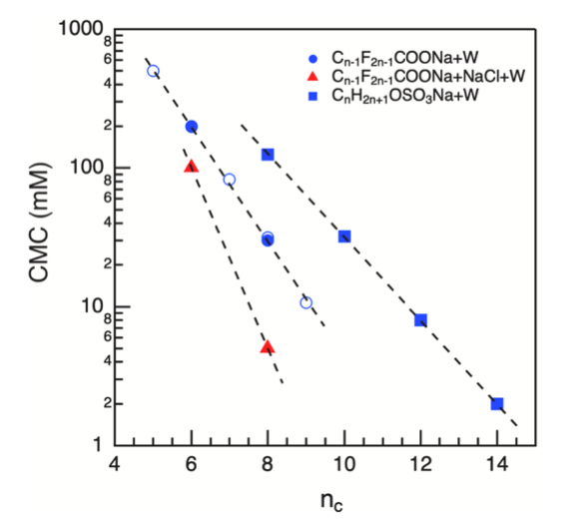
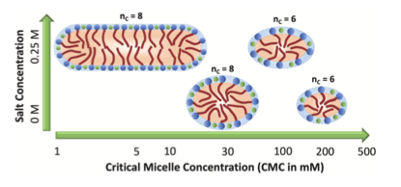
CMC and micelles
Micellar size is dependent on nature (shape, size etc.) of molecules
Non-ionic micelles (detergents) contain ~ 1000 molecules
Ionic micelles contain fewer molecules (ca 10- 100) due to electrostatic repulsion
Size depends approximately on length of hydrophobic tail
Kancharla, S., Jahan, R., Bedrov, D., Tsianou, M., & Alexandridis, P. (2021). Role of chain length and electrolyte on the micellization of anionic fluorinated surfactants in water. Colloids and Surfaces A: Physicochemical and Engineering Aspects, 628, 127313.

Slide 29
Learning Outcomes
Today we have:
Discussed some key applications of micelles
Derived thermodynamic equations that describe micellar behaviour at interfaces and in the bulk
Applied graphical methods to determine micellar properties from experimental data
Understood how surfactant structure changes micellar behaviour

